Slide 1
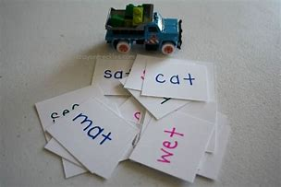
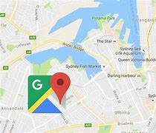
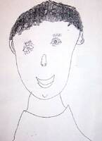
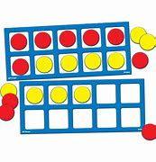
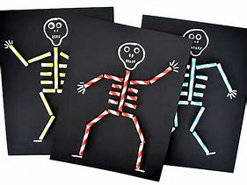
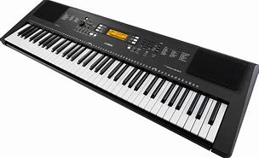
Big Picture
We will be getting to know each other and settling into our new classes. We will be discussing our likes and dislikes, learning about jobs in the community and about our bodies.
As readers and writers we will be learning to recognises letters by their sounds and learning to blend and segment the sounds in words in order to read and write simple words and sentences.
As mathematicians we will be learning about place value, addition and subtraction.
As artists we will be learning to create self portraits and developing our mark making skills with a range of mark making tools.
As musicians we will be exploring the instruments available in our continuous provision and begin to read notation to play nursery rhymes.
As athletes we will learn to navigate obstacles and learn to balance and jump with control.
As scientists we will learn about the parts of the body and role play as doctors and vets.
As historians we will looks at our family trees.
As geographers we will look at google maps to find our houses and learn about directional language.
Elm Tree Primary School
Me and My Community
The Elm Tree Way
To feel Safe, Happy, Special and have Needs Met
By being Caring, Consistent and Calm at all times.

Slide 2
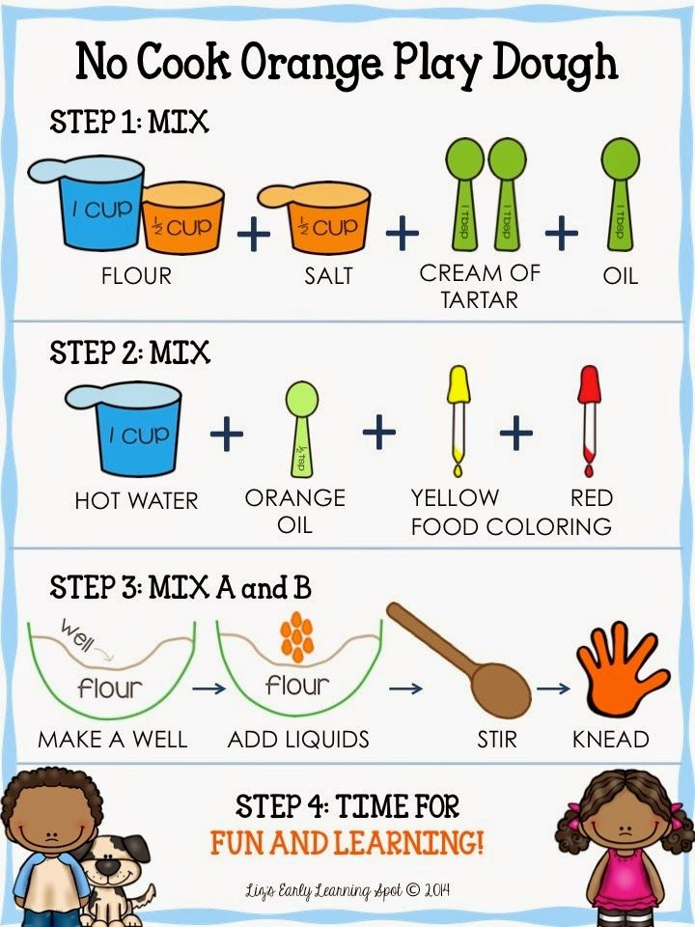
Fine Motor
Practise developing fine motor skills by making some playdough at home and making models of your favourite characters.
Literacy and Mark Making
Draw a picture of your family. Can you label your picture with everyone’s names?
Practise drawing a self portrait by looking in a mirror or at a photograph.
Read picture books and discuss the illustrations and what happens in the story.
Take a trip to the library to borrow some books.
Make up your own story using familiar characters and ask and adult to write it down.
Home Learning Ideas
Autumn 1 Half Term
The Elm Tree Way
To feel Safe, Happy, Special and have Needs Met
By being Caring, Consistent and Calm at all times.
Maths
Practise counting collections of objects
Practise adding two groups of objects together
Go on a number hunt around the home and in your community. Can you find numbers 1-10?
Turn Taking
Play some board games, such as snakes and ladders, with your family

