Slide 1
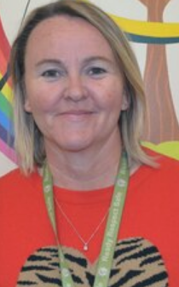
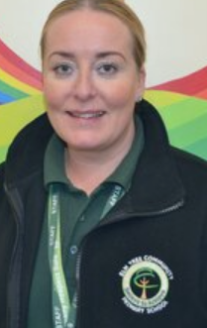
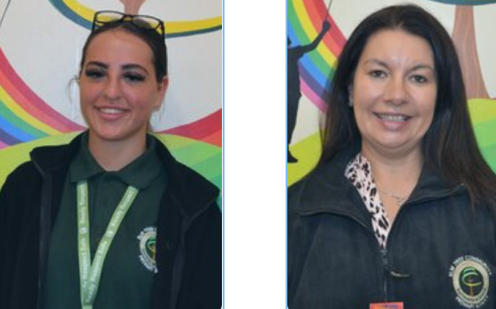
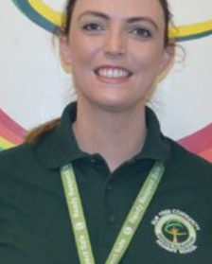
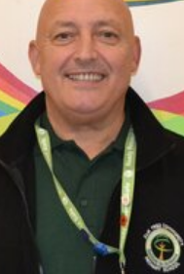
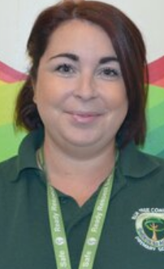
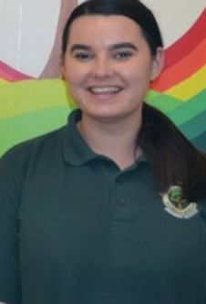
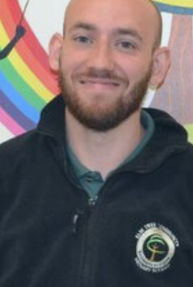
Do you recognise any of these people?
Notes:
What do they all have in common?

Slide 2
Notes:
What do you think National Teaching Assistant day is?

Slide 3
What is National Teaching Assistant Day?
National Teaching Assistants’ Day is an awareness day taking place on 16 September.

Slide 4
I love my job because I love helping the children to reach their dreams.

Slide 5
I love my job because I get to work with the children everyday! I also get to laugh AT LEAST once a day.

Slide 6
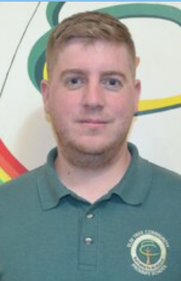
I love my job because its great to see the journey our children go on and see all that they achieve.
I love my job because everyday is different.

Slide 7
Leave them a note!
1 word to tell your TA’s how they make you feel.
Heard
Inspired
Valued Respected
Appreciated Ready
Safe
Notes:
Birthdays

